Slide 1

Fake News Detector
Raquel figueiredo

Slide 2

Outline
Fake News;
Dataset;
Exploring the Data;
Models;
Conclusions.

Slide 3
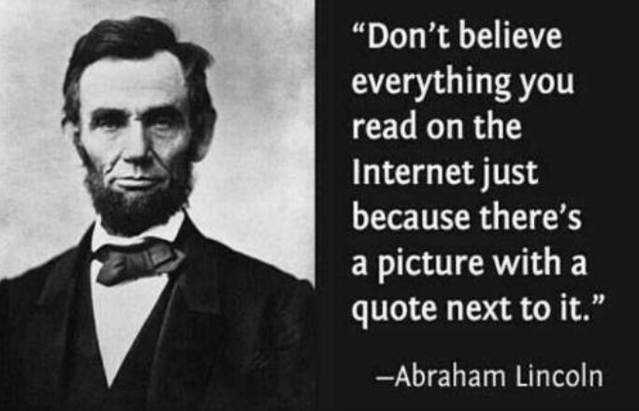
Fake News
False news and rumours throughout history:
  Monopoly on means of mass communication;
  Official media as source of sensationalism and ideology;
  Authoritarian governments’ propaganda machine;
Fake News and the digital world:
  Democratization of means of communication;
  Distortion and deception of facts;
  Combination of social media and technology: post-truth era.

Slide 4
Fake News - Brazil
Fake News in 2018 elections:
  President’s son is investigated for fomenting fake news;
Fake News during the pandemics:
  Distortion of Covid-19 facts and figures;
  Vaccines;
Fake News in 2022 elections:
  President’s use of social media to contest electoral system;
  Dangerous scenario.

Slide 5
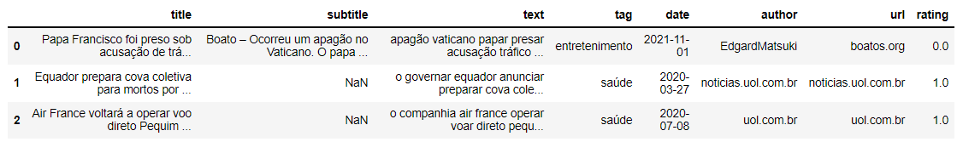
Dataset
Web Scraping (2022):
  AFP Checamos;
  Aos Fatos;
FakeRecogna (2021);
Folha de São Paulo.

Slide 6
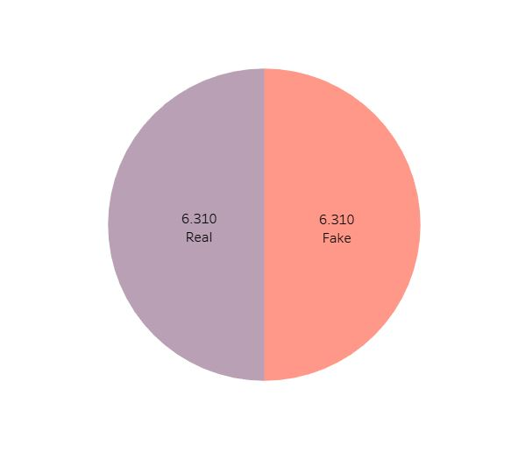
Dataset
Balanced data;
Split:
  Validation set – 1000 rows;
  Dataset – 11.620 rows.

Slide 7
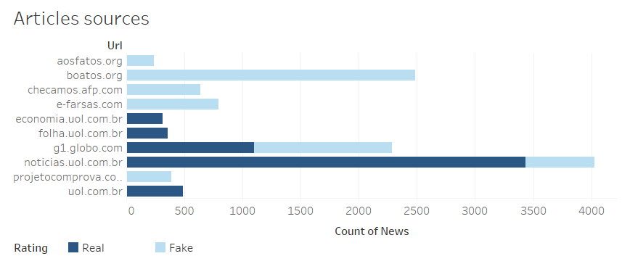
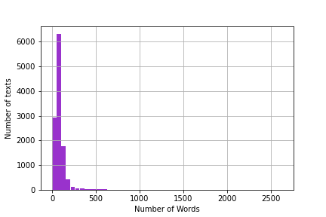
Dataset
Fake and real news are not very balanced in terms of sources;
Most news have few words;
Few articles have more than 500 words;

Slide 8
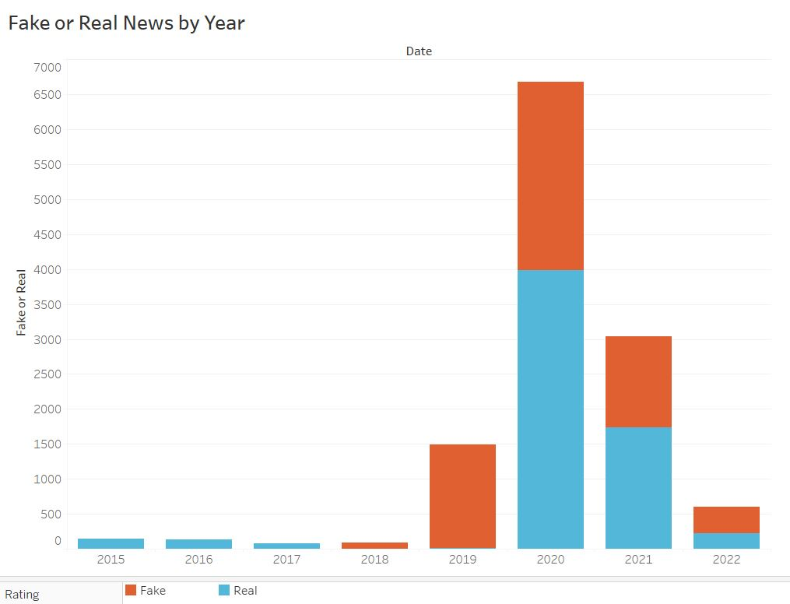
Exploring the Data
Follow the expansion of fact check agencies;
Increase of fake news in 2019;
Combating fake news.

Slide 9
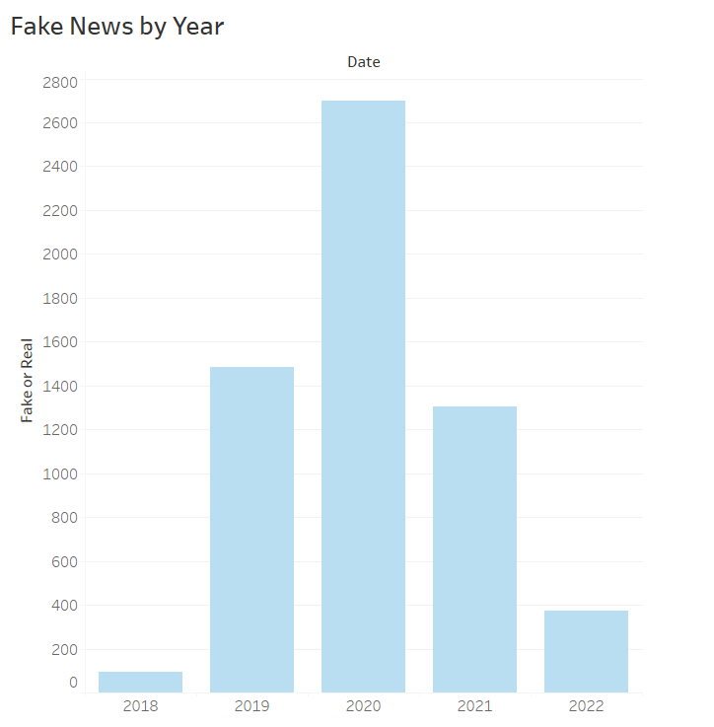
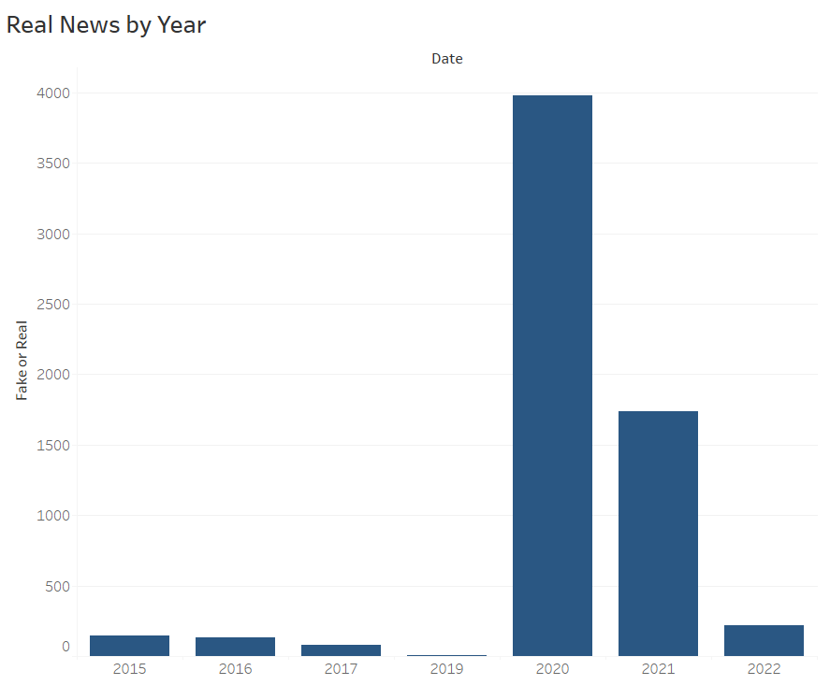

Slide 10
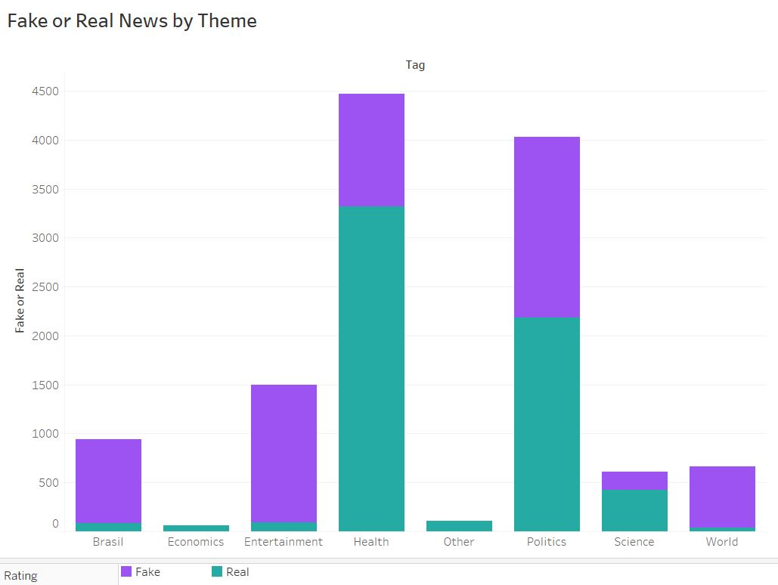
Exploring the Data
Most Fake News on:
  Politics;
  Entertainment;
  Health.

Slide 11
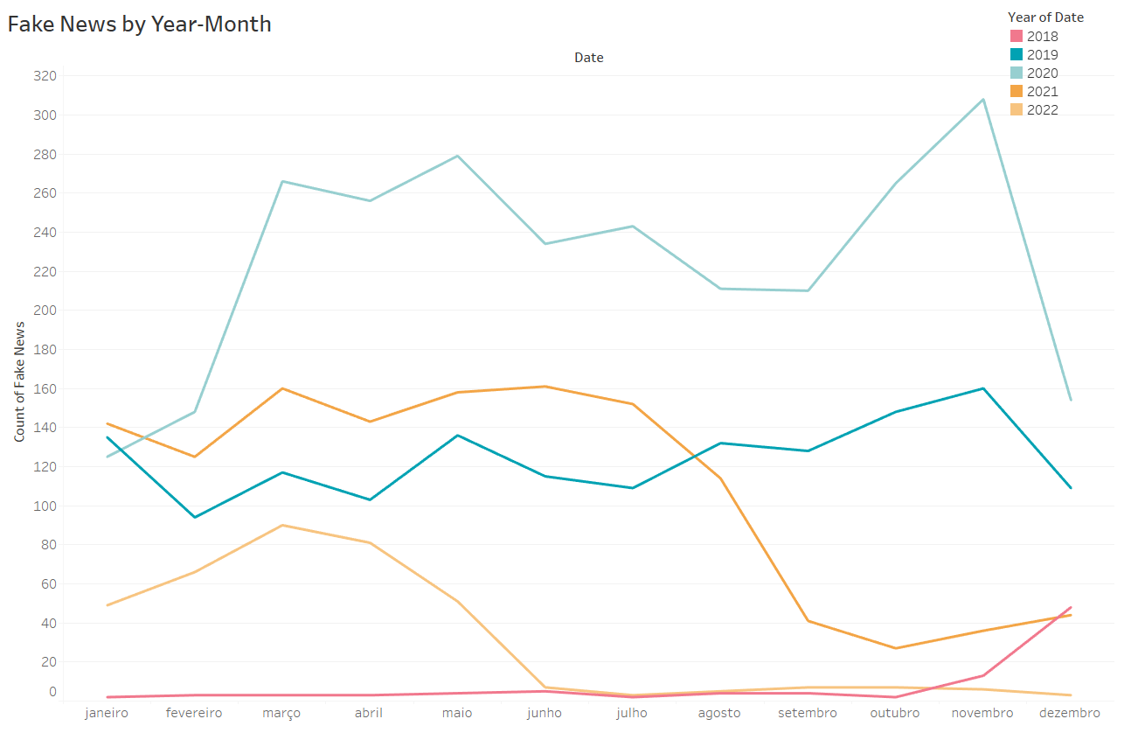
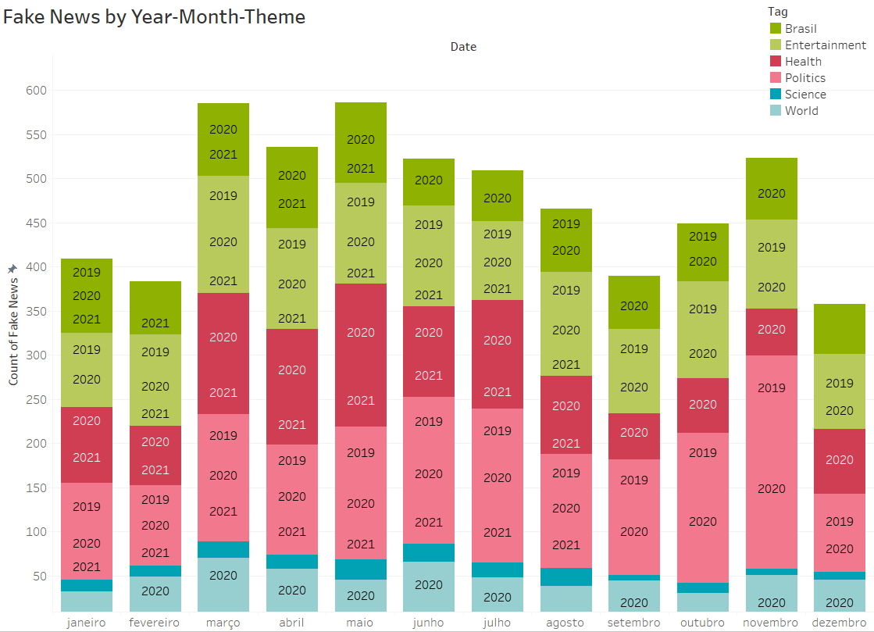
Exploring the Data

Slide 12
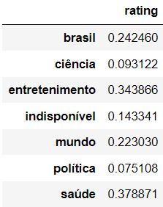
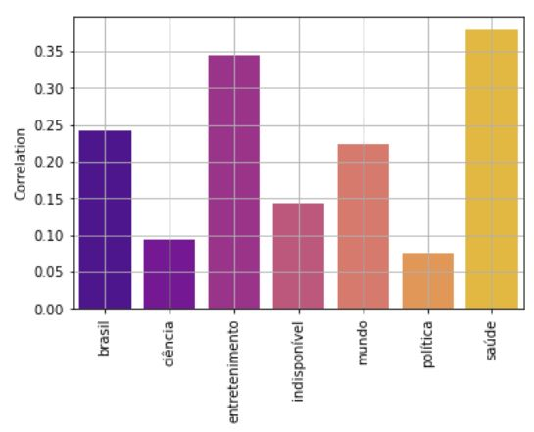
Exploring the Data - Correlation
Themes and Fake News

Slide 13
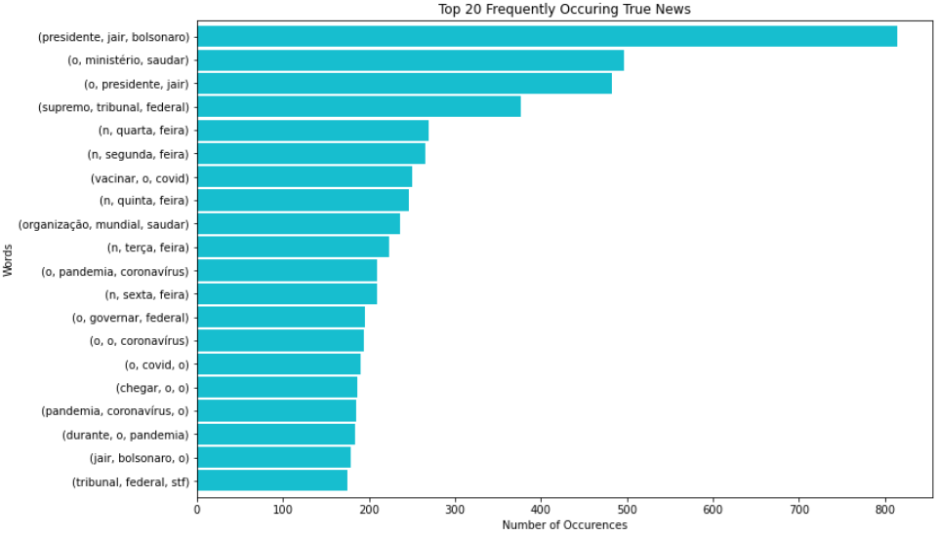
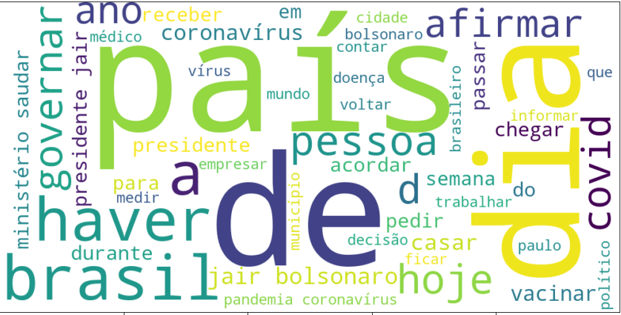
Words in True News

Slide 14
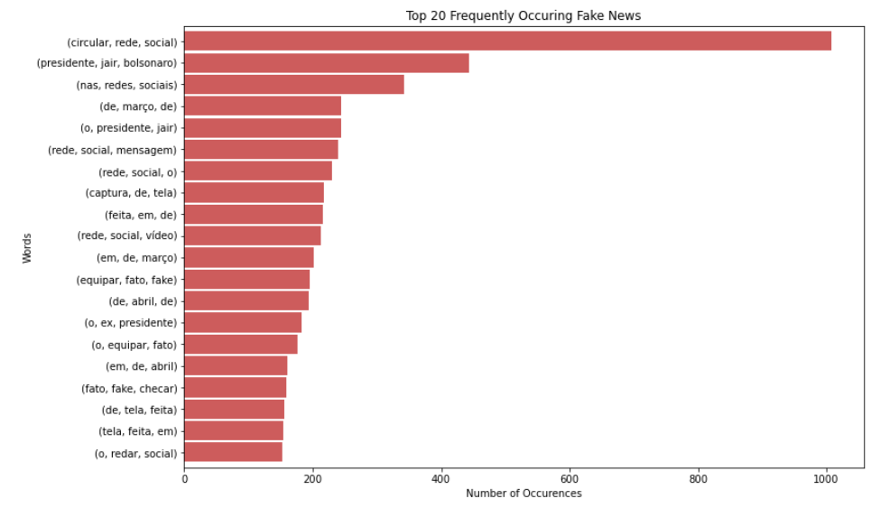
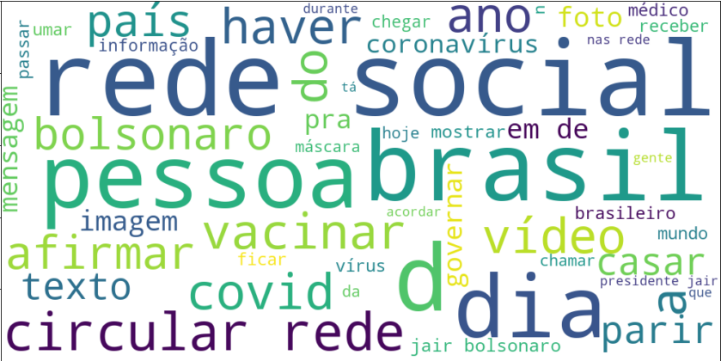
Words in Fake News

Slide 15
Preparing Data for NLP
Tokenizing with word_tokenizer;
Stemmer;
Lemmatizing;
Remove stopwords – Portuguese;
K-best features: title, author, text.

Slide 16
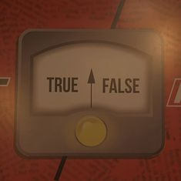
Fake News Detector - Models
First Model attempt:
  Running different feature combinations;
  Simple encoding (One Hot encoding);
  Pipeline.

Slide 17
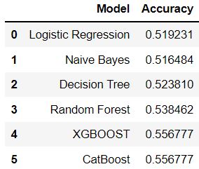
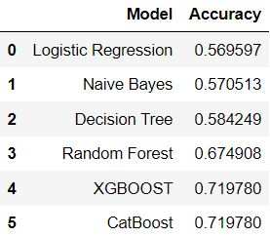
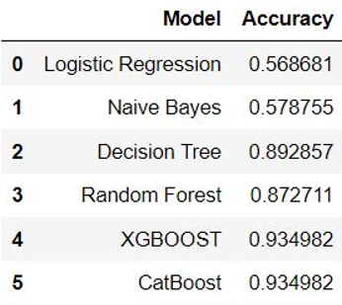
Fake News Detector – 1st Attempt
Top 3 K-beast features
Model with Title
Model with Title + Author (biased?)

Slide 18
Fake News Detector – 2nd Attempt
Different feature combinations;
Different methods to convert text to numericals:
  Countvectorizer;
  TfidfVectorizer;
Different classifiers:
  Multinomial Naive Bayes;
  Linear SVC.

Slide 19
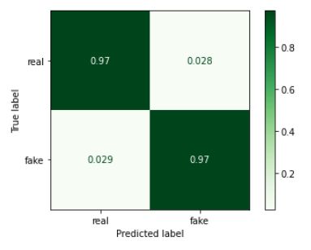
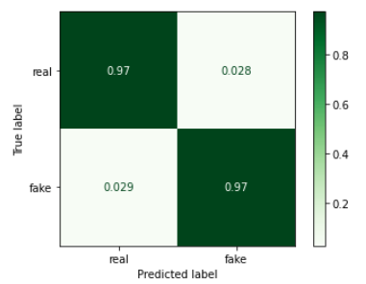
Fake News Detector – 2nd Attempt
Countvectorizar + Linear SVC – Accuracy: 0.97
Title+Author+Text
TfidfVectorizer + Linear SVC – Accuracy: 0.97
Title+Author+Text

Slide 20
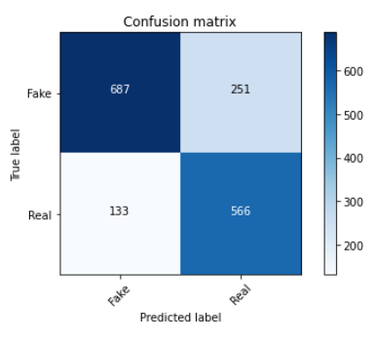
Fake News Detector – 3rd Attempt
BERT is a pretrained neuralnet model for NLP;
BERTimbau Base for Brazilian Portuguese:
  Named Entity Recognition (LENER);
  Sentence Textual Similarity;
  Recognizing Textual Entailment;
Accuracy score: 0.77.

Slide 21
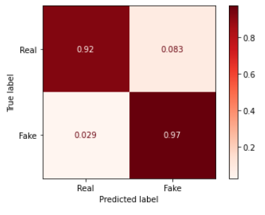
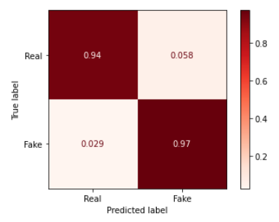
Fake News Detector - Validation
Countvectorizar + Linear SVC – Accuracy: 0.94
Title+Author+Text
TfidfVectorizer + Linear SVC – Accuracy: 0.96
Title+Author+Text

Slide 22
Conclusions
NLP leaves room for a lot of experimentation;
More balanced dataset in terms of text and source;
Raw data for validation – Facebook, Youtube, Twitter, Whatsapp;
Neural Network to detect manipulated pictures.

